Slide 1

Cloud Concepts
AZ-900: Microsoft Azure Fundamentals

Slide 2
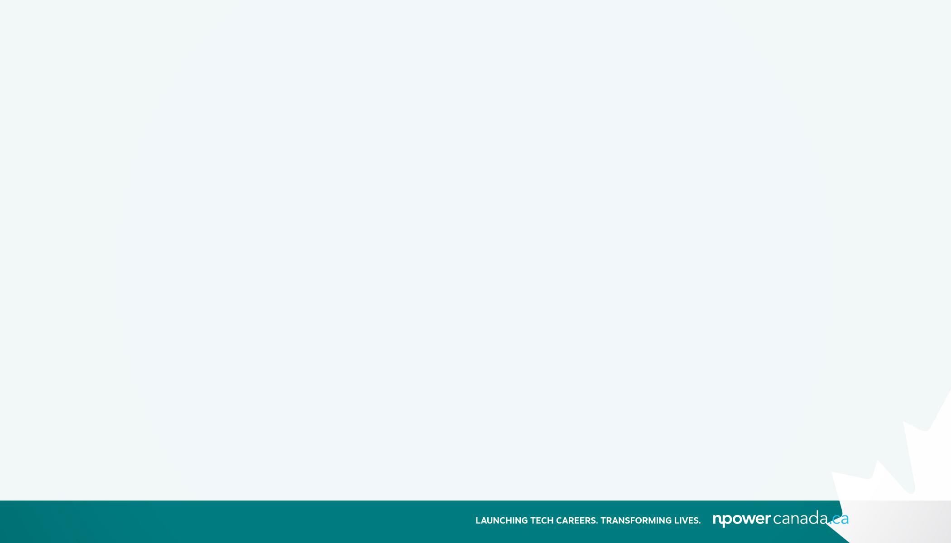
Exam objectives
Modules:
Describe cloud concepts (25%- 30%)
Describe the benefits of using cloud services (35—40%)
Describe cloud service types (30—35%)

Slide 3
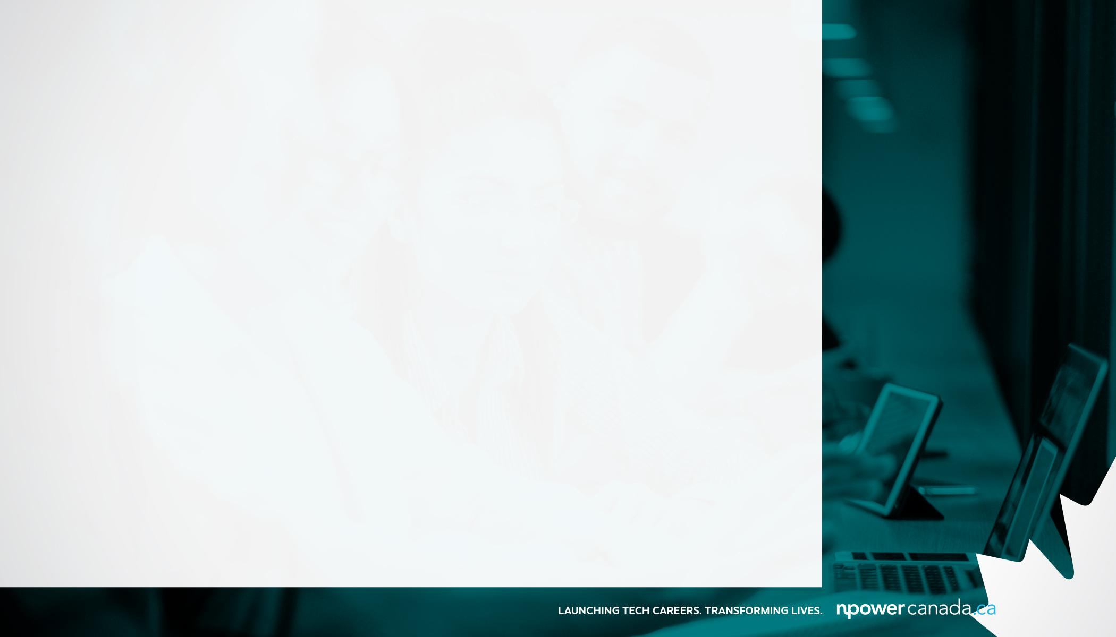
Module 1:
Describe cloud concepts
Define cloud computing
Describe the shared responsibility model
Define cloud models, including public, private, and hybrid
Describe the consumption-based model
Compare cloud pricing models

Slide 4
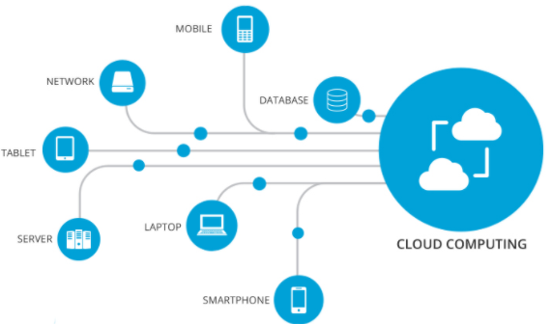
What is cloud computing?
It is the delivery of computing services over the internet, which is otherwise known as the cloud.
These services include servers, storage, databases, networking, software, analytics, and intelligence.
It uses a pay-as-you-go pricing model. You typically pay only for the cloud services you use, which helps you:
to lower your operation costs
scale your business needs
run your infrastructure more efficiently

Slide 5
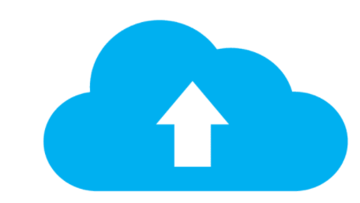
Why move to the cloud?
A pool of raw compute, storage, and networking components
Speech recognition and other cognitive services that help make your application stand out from the crowd
Analytics services that deliver telemetry data from your software and devices

Slide 6
Shared responsibility model
You’ll always be responsible for | The cloud provider is always responsible for | Your service model will determine responsibility for things like
The information and data stored in the cloud | The physical datacenter | Operating systems
Devices that are allowed to connect to your cloud (cell phones, computers, and so on) | The physical network | Network controls
The accounts and identities of the people, services, and devices within your organization | The physical hosts | Applications Identity and infrastructure

Slide 7
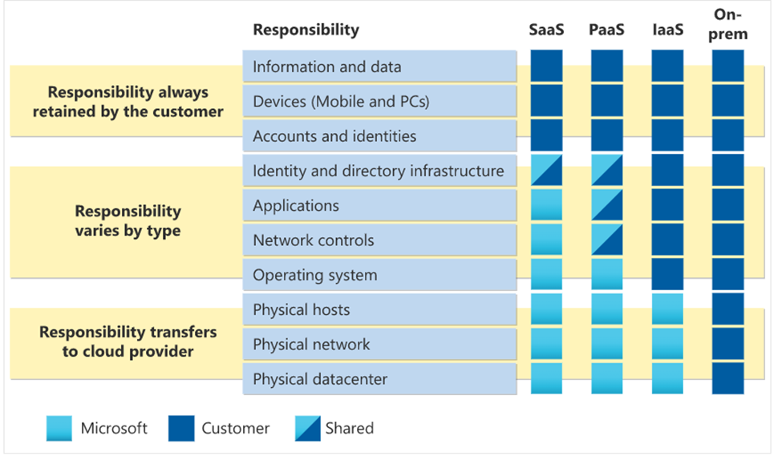
Shared responsibility model
https://learn.microsoft.com/en-us/training/modules/describe-cloud-compute/4-describe-shared-responsibility-model?ns-enrollment-type=learningpath&ns-enrollment-id=learn.wwl.microsoft-azure-fundamentals-describe-cloud-concepts

Slide 8
Define cloud models
There are three deployment models for cloud computing: public cloud, private cloud, and hybrid cloud. Each deployment model has different aspects that you should consider as you migrate to the cloud.
Deployment model | Description
Public cloud | Services are offered over the public internet and available to anyone who wants to purchase them. Cloud resources like servers and storage are owned and operated by a third-party cloud service provider and delivered over the internet.
Private cloud | Computing resources are used exclusively by users from one business or organization. A private cloud can be physically located at your organization's on-site datacenter. It also can be hosted by a third-party service provider.
Hybrid cloud | This computing environment combines a public cloud and a private cloud by allowing data and applications to be shared between them.

Slide 9
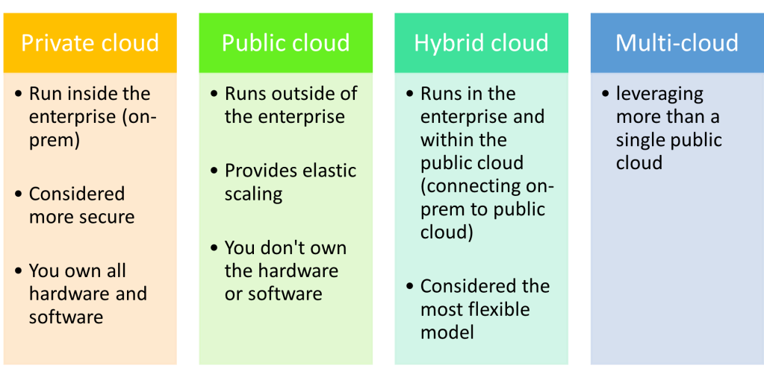
Reference :https://multi-cloud-solutions.com/2022/04/18/multi-cloud/

Slide 10
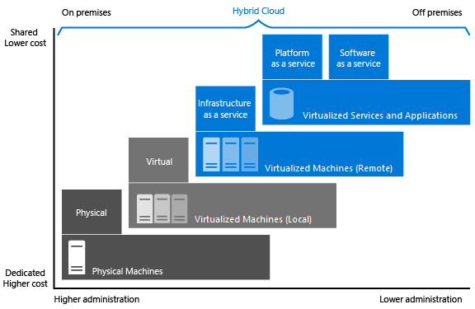
Deployment Models (cont’d)
Ref: https://docs.microsoft.com/en-us/learn/modules/intro-to-azure-fundamentals/what-is-cloud-computing

Slide 11
Describe the consumption-based model
Capital Expenditure vs Operational Expenditure
CapEx | OpEx
Capital expenditures (CapEx) refers to long-term business investments. It’s expected that CapEx will continue to benefit the business in the future and eventually pay for itself. Maintenance increases the life and utility of a CapEx item is therefore also a capital expenditure. | Operating expenditures (OpEx) are incurred in the day-to-day operation of a business, and generally include services or items expected to be used within a year. While operating expenditures are no less important than capital expenditures, they are not considered long-term investments.
A typical on-premise IT infrastructure generally requires significant CapEx including hardware, equipment, and maintenance. The upfront costs are predictable, but the lifetime of CapEx items and total maintenance costs are uncertain. | a cloud environment on a platform like Microsoft Azure operates on an OpEx model where a company only pays for what it needs at the specific point in time, on a monthly basis. Risks are lower and no equipment maintenance is required.
inherent inflexibility. You may end up paying for capacity your business does not require in the future, or in the future end up in the painstaking and expensive process of increasing capacity. | The OpEx model of cloud computing offers companies significantly more flexibility and agility. Microsoft Azure scales up or down to meet your specific capacity needs and budget.

Slide 12
Module 2:
Describe the benefits of using cloud services
Describe the benefits of high availability and scalability in the cloud
Describe the benefits of reliability and predictability in the cloud
Describe the benefits of security and governance in the cloud
Describe the benefits of manageability in the cloud

Slide 13
What are some cloud computing advantages?
High availability | Depending on the service-level agreement that you choose, your cloud-based applications can provide a continuous user experience with no apparent downtime even when things go wrong.
Scalability | Applications in the cloud can be scaled in two ways: Vertically: Computing capacity can be increased by adding RAM or CPUs to a virtual machine. Horizontally: Computing capacity can be increased by adding instances of a resource, such as adding more virtual machines to your configuration.
Elasticity | Cloud-based applications can be configured to take advantage of autoscaling, so your applications will always have the resources they need.
Agility | Cloud-based resources can be deployed and configured quickly as your application requirements change
Geo-distribution | Applications and data can be deployed to regional data centers around the globe, so your customers always have the best performance in their region
Disaster recovery | By taking advantage of cloud-based backup services, data replication, and geo-distribution, you can deploy your applications with the confidence that comes from knowing that your data is safe in the event that disaster should occur.

Slide 14
Describe the benefits of reliability and predictability in the cloud
Reliability | Reliability is the ability of a system to recover from failures and continue to function. With a decentralized design, the cloud enables you to have resources deployed in regions around the world. With this global scale, even if one region has a catastrophic event other regions are still up and running. You can design your applications to automatically take advantage of this increased reliability. In some cases, your cloud environment itself will automatically shift to a different region for you, with no action needed on your part.
Predictability | Predictability in the cloud lets you move forward with confidence. Predictability can be focused on: performance predictability cost predictability. Both
Notes:
Performance predictability focuses on predicting the resources needed to deliver a positive experience for your customers. Autoscaling, load balancing, and high availability are just some of the cloud concepts that support performance predictability. If you suddenly need more resources, autoscaling can deploy additional resources to meet the demand, and then scale back when the demand drops. Or if the traffic is heavily focused on one area, load balancing will help redirect some of the overload to less stressed areas.
Cost predictability is focused on predicting or forecasting the cost of the cloud spend. With the cloud, you can track your resource use in real time, monitor resources to ensure that you’re using them in the most efficient way, and apply data analytics to find patterns and trends that help better plan resource deployments. By operating in the cloud and using cloud analytics and information, you can predict future costs and adjust your resources as needed. You can even use tools like the Total Cost of Ownership (TCO) or Pricing Calculator to get an estimate of potential cloud spend.

Slide 15
Benefits of manageability in the cloud
Management of the cloud speaks to managing your cloud resources. In the cloud, you can:
Automatically scale resource deployment based on need.
Deploy resources based on a preconfigured template, removing the need for manual configuration.
Monitor the health of resources and automatically replace failing resources.
Receive automatic alerts based on configured metrics, so you’re aware of performance in real time.

Slide 16
Module 3:
Describe cloud service types
Describe infrastructure as a service (IaaS)
Describe platform as a service (PaaS)
Describe software as a service (SaaS)
Identify appropriate use cases for each cloud service (IaaS, PaaS, SaaS)

Slide 17
Shared responsibility model
IaaS | A cloud provider keeps the hardware up to date, but operating system maintenance and network configuration is left to the cloud tenant.
PaaS | This cloud service model is a managed hosting environment. The cloud provider manages the virtual machines and networking resources, and the cloud tenant deploys their applications into the managed hosting environment.
SaaS | In this cloud service model, the cloud provider manages all aspects of the application environment, such as virtual machines, networking resources, data storage, and applications. The cloud tenant only needs to provide their data to the application managed by the cloud provider.

Slide 18
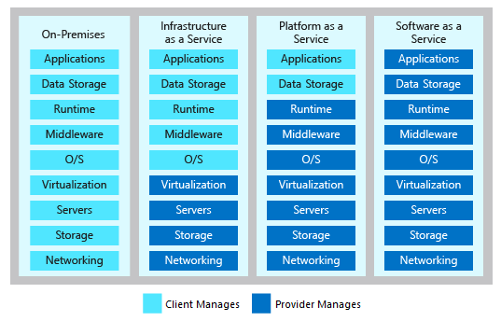
Cloud Service models (cont’d)
Ref: https://docs.microsoft.com/en-us/learn/modules/intro-to-azure-fundamentals/what-is-cloud-computing

Slide 19
Iaas
Scenarios
Lift-and-shift migration: You’re setting up cloud resources similar to your on-prem datacenter, and then simply moving the things running on-prem to running on the IaaS infrastructure.
Testing and development: You have established configurations for development and test environments that you need to rapidly replicate. You can start up or shut down the different environments rapidly with an IaaS structure, while maintaining complete control.

Slide 20
Paas
Scenarios
Development framework: PaaS provides a framework that developers can build upon to develop or customize cloud-based applications. Similar to the way you create an Excel macro, PaaS lets developers create applications using built-in software components. Cloud features such as scalability, high-availability, and multi-tenant capability are included, reducing the amount of coding that developers must do.
Analytics or business intelligence: Tools provided as a service with PaaS allow organizations to analyze and mine their data, finding insights and patterns and predicting outcomes to improve forecasting, product design decisions, investment returns, and other business decisions.

Slide 21
Saas
Scenarios
Email and messaging.
Business productivity applications.
Finance and expense tracking.

Slide 22
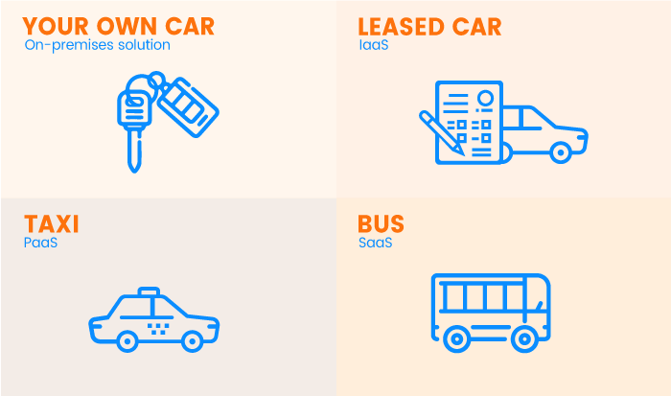
https://rubygarage.org/blog/iaas-vs-paas-vs-saas
Notes:
On-premises IT
infrastructure is like owning a car. When you buy a car, you’re responsible for its maintenance, and upgrading means buying a new car.
IaaS
is like leasing a car. When you lease a car, you choose the car you want and drive it wherever you wish, but the car isn’t yours. Want an upgrade? Just lease a different car!Common examples: DigitalOcean, Linode, Rackspace, Amazon Web Services (AWS), Cisco Metapod, Microsoft Azure, Google Compute Engine (GCE) are some popular examples of Iaas.
PaaS
is like taking a taxi. You don’t drive a taxi yourself, but simply tell the driver where you need to go and relax in the back seat.Common examples: AWS Elastic Beanstalk, Windows Azure, Heroku, Force.com, Google App Engine, Apache Stratos.
SaaS
is like going by bus. Buses have assigned routes, and you share the ride with other passengers.Common examples: Google Apps, Microsoft office365, Google docs, Gmail, WHMCS billing software

Slide 23
References:
https://docs.microsoft.com/en-us/learn/paths/az-900-describe-cloud-concepts/
https://www.youtube.com/watch?v=HfZ1kgHlrfg&list=PLYGZ9Q0oTOHfsI-3IAhvyc09ssPDfoePv
https://www.linkedin.com/learning/paths/prepare-for-the-azure-fundamentals-certification-az-900

